Slide 1

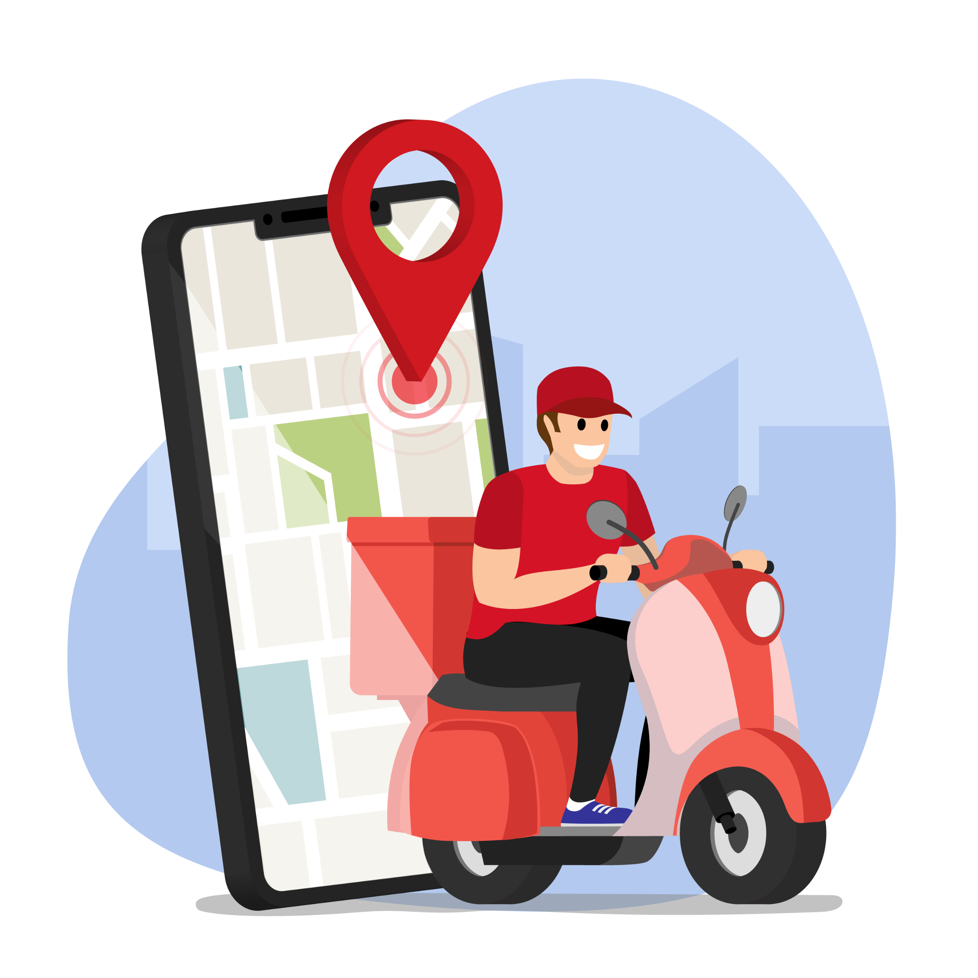
Zomato
Data Analysis
B Harish Ragavendra

Slide 2

Zomato Business model
Restaurant Listings & Reviews Zomato helps users find restaurants, view menus, and read reviews.
Online Food Delivery Zomato delivers food by connecting customers with
restaurants and delivery partners.
Earning from Restaurants & Ads Zomato makes money by charging restaurants for ads,
delivery commissions, and software tools.

Slide 3

Types of Data Analysis
Descriptive Analysis Understanding basic features and distributions in the data:
Distribution of Average Cost for Two
Distribution of Restaurant Ratings
Online Order Availability
Table Booking Availability
Comparative Analysis Comparing two or more variables to find relationships:
Cost for Two vs Rating
Online Order vs Table Booking availability
Categorical Insights & Ranking Identifying top trends and categories:
Top 10 Areas with Most Restaurants
Top 10 Cuisines
Top 10 Restaurant Types

Slide 4

Tools used
Python – Core programming language used for data analysis
Pandas – For data loading, cleaning, and manipulation
NumPy – For numerical operations and data handling
Matplotlib – For creating basic visualizations
Seaborn – For advanced and attractive statistical plots
Google Collab – For interactive code development and visualization

Slide 5

Workflow
Data Collection
Data Cleaning & Preparation
Exploratory Data Analysis (EDA)
Data Visualization
Insight Generation
Conclusion & Recommendations

Slide 6

Let’s Get into the
Business Problems

Slide 7
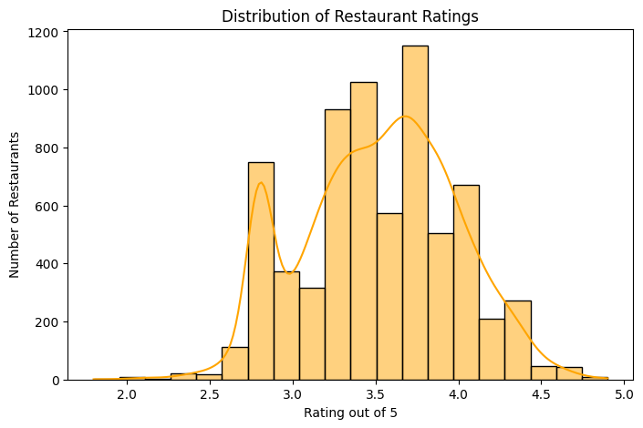
.
1.Distribution of Restaurant Rating :
Most restaurants have ratings clustered between 3.5 and 4.5, indicating generally positive customer experiences
Rate (out of 5)
3.4
3.9
3.7
2.7
2.8
3.4
4.1
2.8
3.2

Slide 8
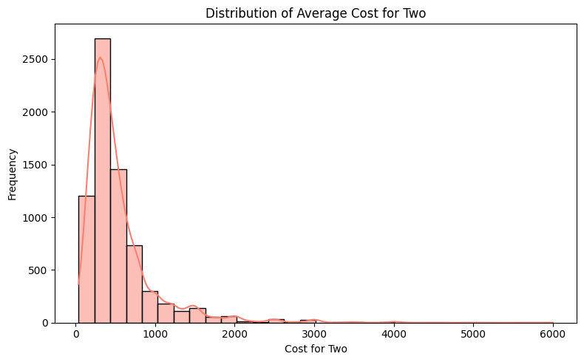
2.Distribution of Average Cost for Two People:
The average cost for two is most commonly in the lower price range, suggesting that affordable dining options are more prevalent.
Avg cost (two people)
200
400
400
550
700
200
700

Slide 9
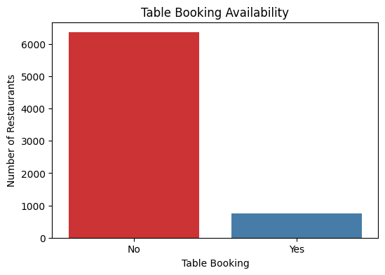
3.Table Booking Availability :
A majority of restaurants do not offer table booking, indicating that walk-in service is more common.
Table booking
No
No
No
No
No
No
No

Slide 10
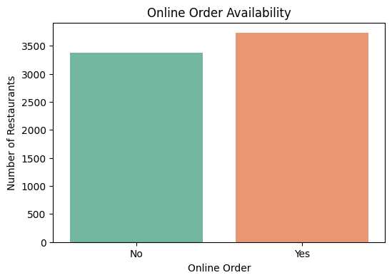
4.Online Order Availability :
Most restaurants support online ordering, reflecting a strong shift toward digital convenience in food services.
Online order
No
Yes
Yes
Yes
Yes
No
Yes

Slide 11
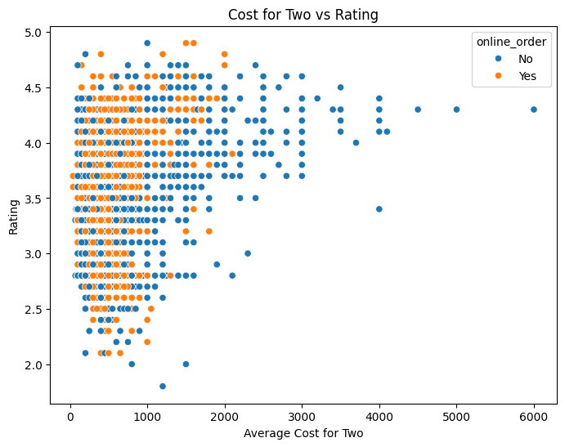
5.Cost for Two People vs Rating :
There is no strong correlation between cost for two and rating, indicating that higher prices do not necessarily guarantee better customer satisfaction.
Rate (out of 5) | Avg cost (two people) | Online_order
3.4 | 200 | No
3.9 | 400 | Yes
3.7 | 400 | Yes
2.7 | 550 | Yes
2.8 | 700 | Yes
3.4 | 200 | No

Slide 12
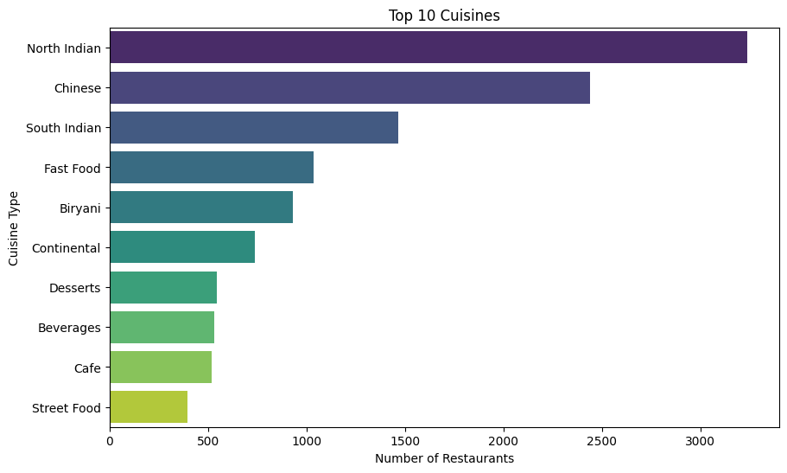
6.Top 10 Cuisines :
North Indian and Chinese cuisines are the most popular, dominating the top 10 list and reflecting strong customer preferences for these food types.
Cuisines type
Fast Food
Fast Food, Beverages
Cafe, Beverages
Biryani, Mughlai, Chinese
BBQ, Continental, North Indian, Chinese, Beverages
Mughlai, Biryani, Chinese, North Indian

Slide 13
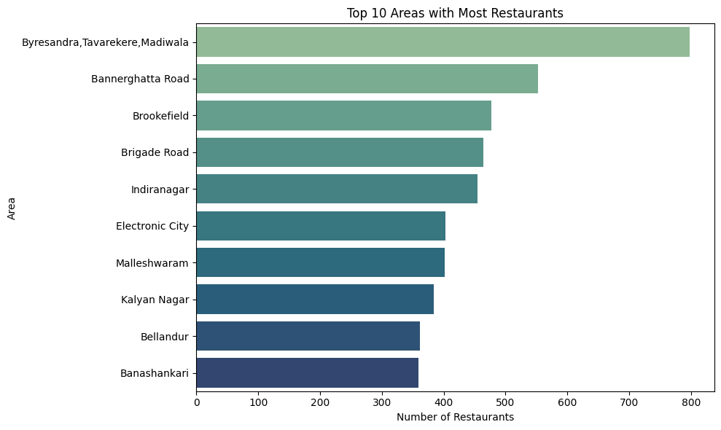
7.Top 10 Areas with Most Restaurants :
The top 10 areas with the most restaurants highlight key food hubs, indicating high customer demand and competitive dining markets in those locations.
Area
Bellandur
Byresandra,Tavarekere,Madiwala
Bannerghatta Road
Marathahalli
Bellandur
Whitefield

Slide 14
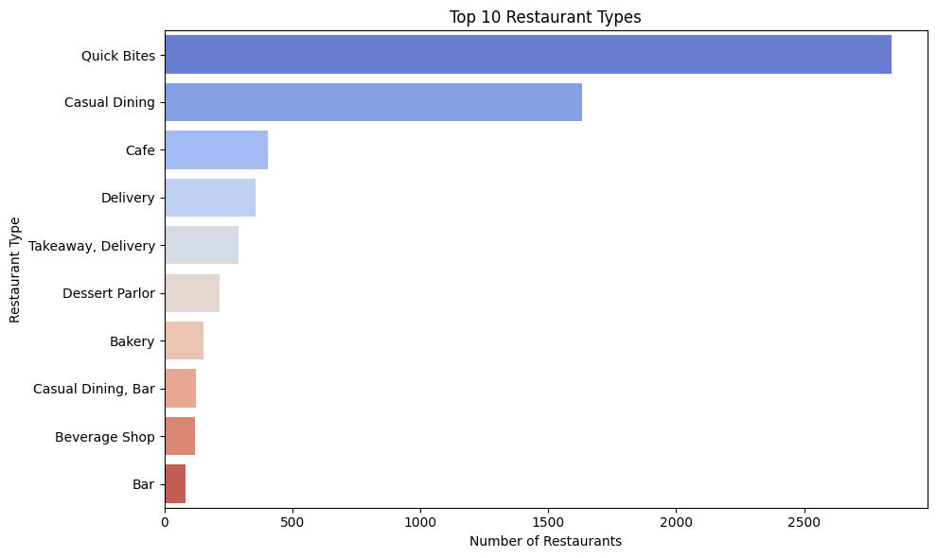
8.Top 10 Restaurant Types :
Quick Bites and Casual Dining are the most common restaurant types, showing a strong preference for informal and fast dining experiences.
Restaurant type
Quick Bites
Quick Bites
Cafe
Casual Dining
Casual Dining
Takeaway, Delivery

Slide 15
Top Key Insights
Ratings Trend: Most restaurants have ratings between 3.5 and 4.5, suggesting generally positive customer satisfaction.
Affordability Dominates: Lower average cost for two is more common, highlighting affordability as a key factor in dining choices.
Booking Preferences: Table booking is not widely available, indicating that most restaurants rely on walk-ins.
Digital Adoption: A majority of restaurants offer online ordering, reflecting the growing importance of digital convenience.
Cost vs Rating: No strong correlation between cost and rating, showing that expensive meals don't always mean better experiences.
Cuisine Popularity: North Indian and Chinese top the cuisine list, showing consistent customer demand for these flavors.
Hotspot Areas: A few key areas dominate in restaurant count, acting as major food and business hubs.
Preferred Dining Styles: Quick Bites and Casual Dining are the leading restaurant types, suggesting customer preference for fast, informal meals.

Slide 16
Actionable Recommendation
Enhance Online Ordering Experience: Since most customers prefer online ordering, invest in optimizing your online menu, delivery speed, and app usability.
Offer Affordable Combos: With lower-cost meals being more popular, create value-for-money combos to attract budget-conscious diners.
Introduce Table Booking Option: Adding table booking could improve customer convenience and reduce walk-in congestion, especially in high-traffic areas.
Focus on High-Demand Cuisines: Expand or refine offerings in popular cuisines like North Indian and Chinese to match customer preferences.
Target Food-Dense Areas: Open or expand outlets in top-performing areas to capitalize on high foot traffic and established customer bases.
Promote Quick and Casual Dining: Tailor your services to match the demand for quick bites and casual dining — e.g., faster service, grab-and-go options.
Monitor Ratings Closely: Since ratings aren’t tied to cost, focus on food quality, service, and ambiance to boost customer satisfaction regardless of pricing.

Slide 17

Thank You

